Slide 1




Begin With Us
Begin With Us
Build. Buy. Collabrate

Slide 2





Problem Statement
Lack of sustainable solutions
and environmentally friendly
practices in agriculture.
01
Marketplace Gaps and many intermediaries in the market
02
03
Barriers for New Agriculture Startups

Slide 3




Solution Overview
Solution 01
New startups can order greenhouse construction materials through our platform.
Solution 02
Existing greenhouse owners can collaborate with GoingGreen and get more customers from our marketplace.
Solution 03
We offer a marketplace for greenhouse-produced vegetables and materials required for greenhouse construction.

Slide 4



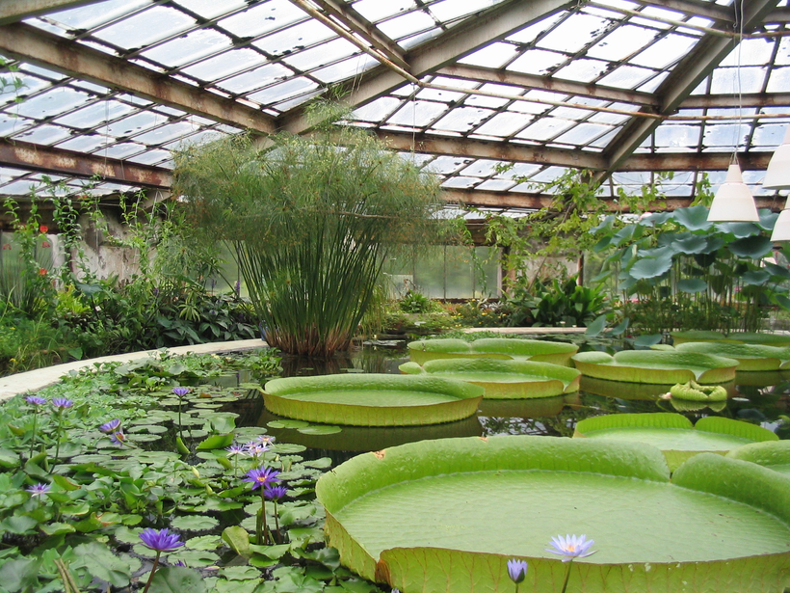
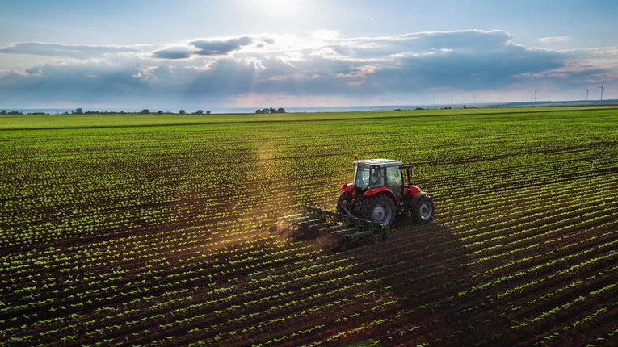

Target Audience
New Start-Up
Exiting Greenhouse
Coporate farmers
Environment Enthusiats

Slide 5
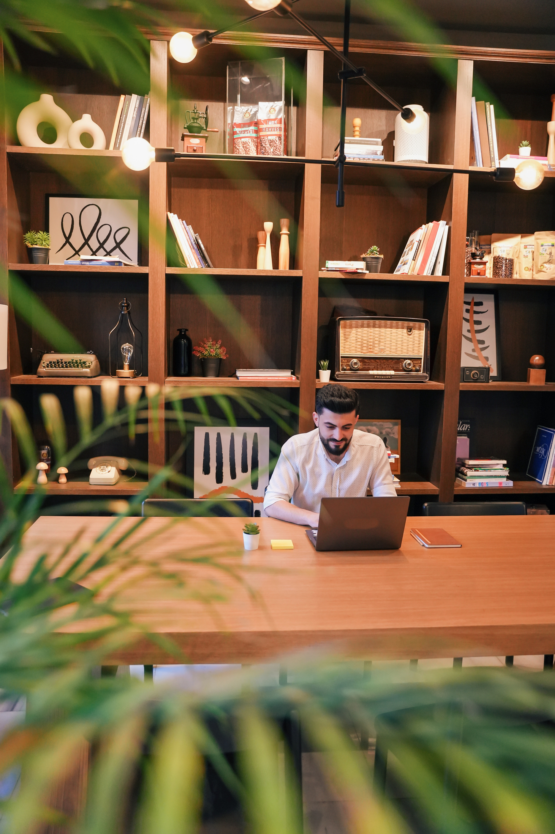
How will we implement
Implementation Plan:
1. Local Partnership:
a. Existing Greenhouse Business
b. Greenhouse Building Materials Supplies
2. Online Platform
3. Awareness Campaign and Marketing
4. Employees: 2 skilled manpower for building purpose, Delivery Person, Technicians
5. Monitoring and Evaluation
6. Adaptation and Scaling
7. Continuous Improvement

Slide 6
How will we implement
Startup includes:
website de
-

Slide 7


To promote sustainable agricultural practices and eco-friendly living through the adoption of smart greenhouse technology.
Mission
And
Vision
In coming years, we vision a synergistic ecosystem that harmonizes urban living with sustainable agriculture, finally making farming a smart green business.

Slide 8





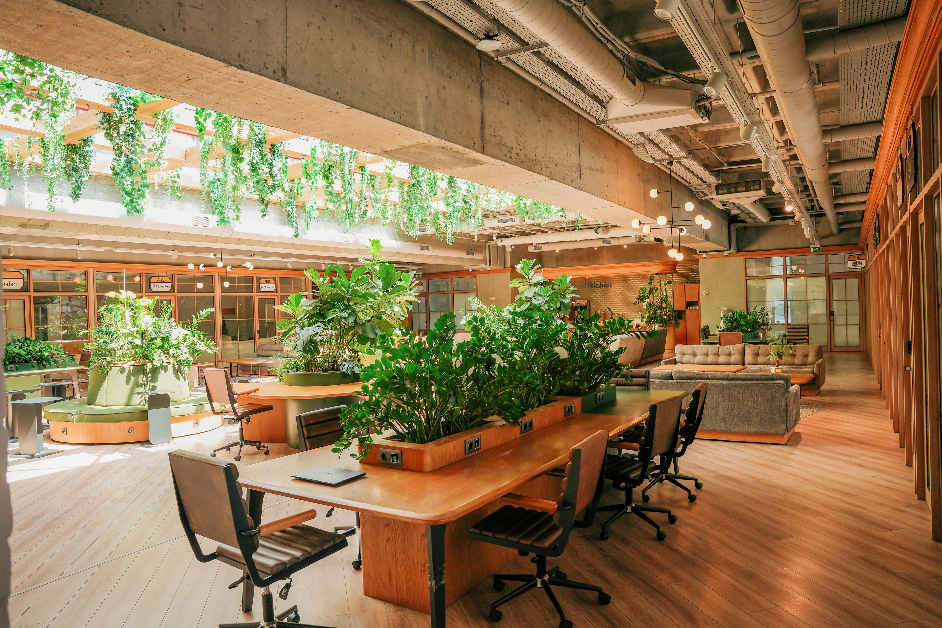
Revenue Model
01 Market Place Transaction Fees
02 Collaboration Subscription Fees
03 Greenhouse Construction and Maintainance
Fees
04 Consultation Fees
05 Advertisement Revenue

Slide 9
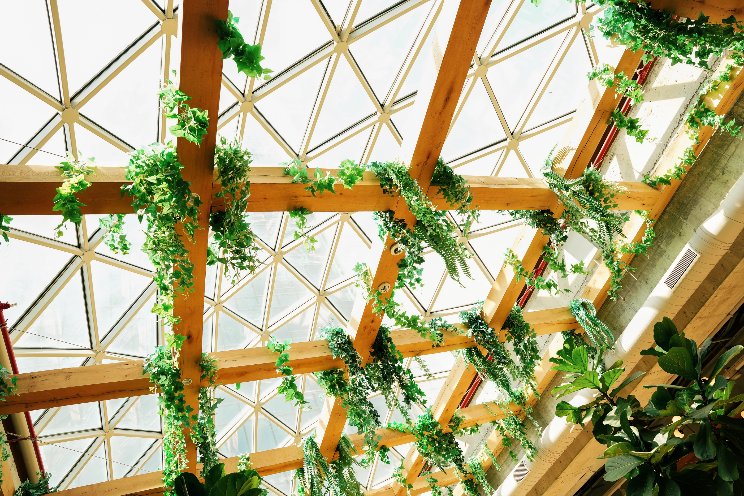



DIFFERENTIATION AND COMPETITIVE ANALYSIS
First-of-its-kind
Producer-To-Consumer
Comprehensive Ecosystem
GoingGreen enjoys a first-mover advantage as the sole business dedicated to revolutionizing the greenhouse ecosystem.
Direct connection between producers (greenhouse startups, farmers) and consumers without the need for intermediaries.
From greenhouse construction services to a robust marketplace for greenhouse products, GoingGreen offers a comprehensive suite of solutions tailored.

Slide 10

FUTURE IDEAS
•Crowd funding Platform for greenhouse Startups.
•Educative platform where high knowledgeable professionals can post their
research and studies.

Slide 11



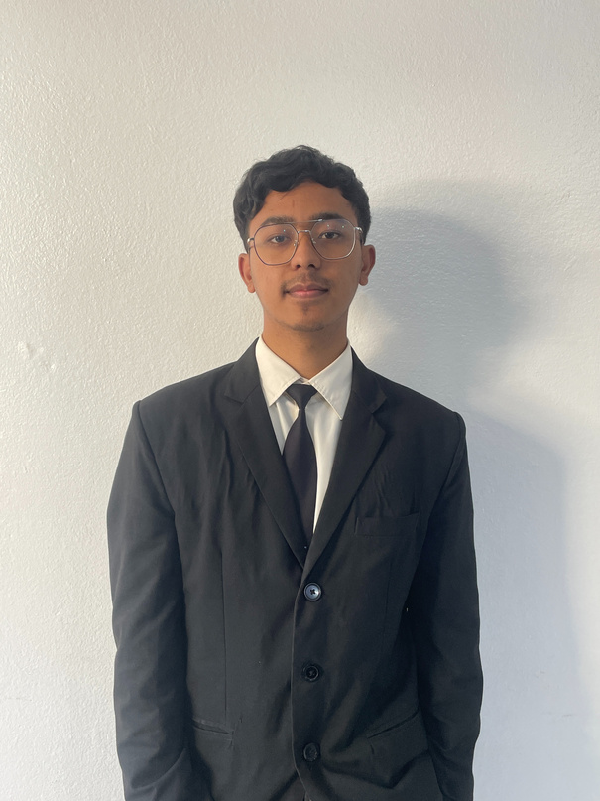
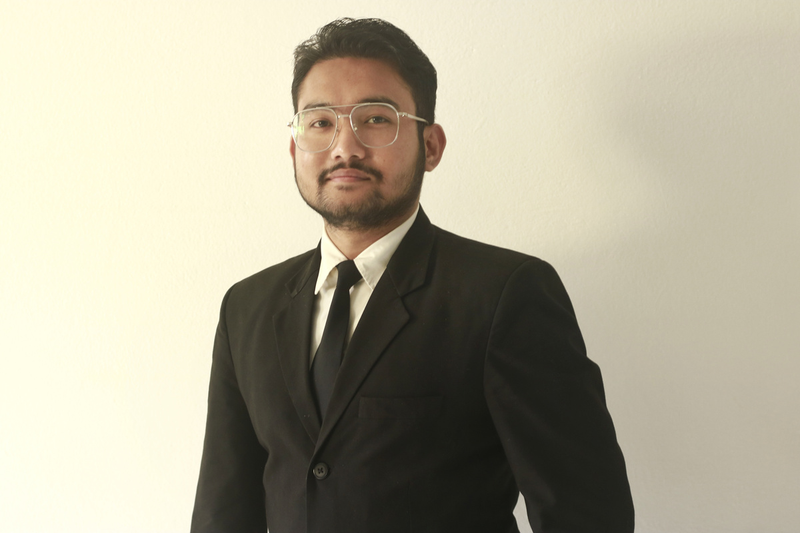

Our Team
Samir
Gurunng
Romina
Deuja
Niwesh
Waiba
Aayush
Shrestha

Slide 12

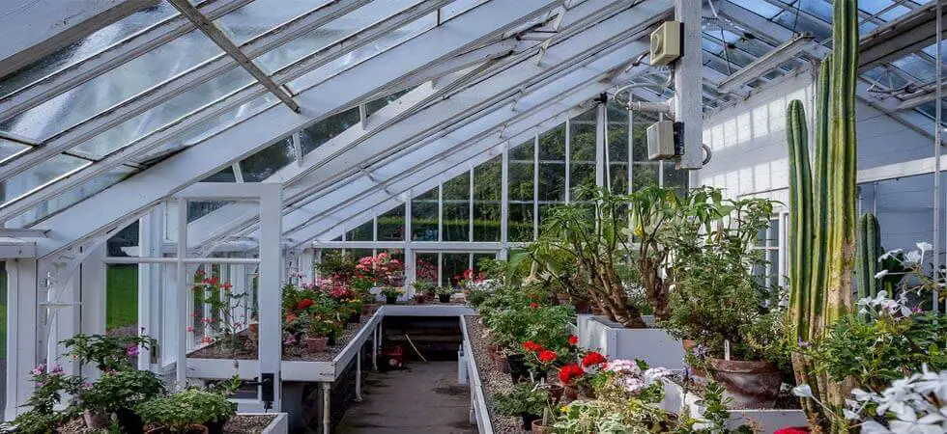
THANK YOU
ODE TO CODE

